Slide 1
Foundations of Data Science
Lesson 10: Data and Code Management

Slide 2
Agenda
API
JSON
Flask
Git

Slide 3
Learning Objectives
By the end of this lesson, you should be able to
Work with APIs
Import/export JSON data
Use Git for version control
Utilize collaboration tools

Slide 4
Installation
GitHub: Setup a GitHub Account: https://docs.github.com/en/get-started/start-your-journey/creating-an-account-on-github
Git: Setup Git: https://docs.github.com/en/get-started/git-basics/set-up-git
Python: You’ll also need to have Python installed locally, as the material in that lecture won’t run properly on JupyterHub.
Install Anaconda: https://www.anaconda.com/download

Slide 5
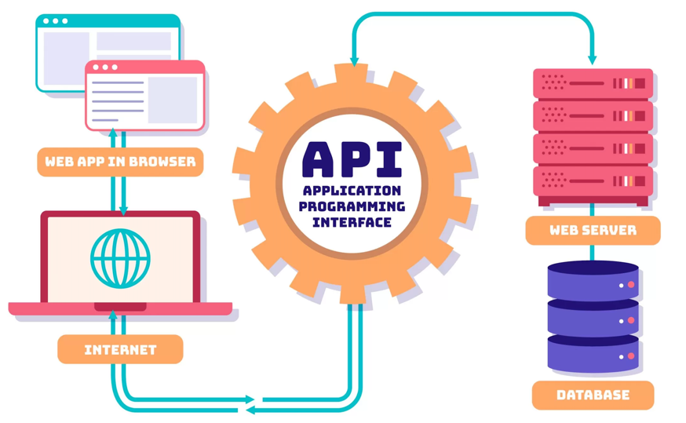
What is an API?
A software-to-software interface that sets rules for communicating data between users and/or applications over the Internet
Uses the Hypertext Transfer Protocol (HTTP)
Enables automation of data exchange between apps
Allows transferring large volumes of data from a server to a client
https://arounda.agency/blog/fintech-api-what-is-it-and-how-does-it-work

Slide 6
API Notes

Slide 7
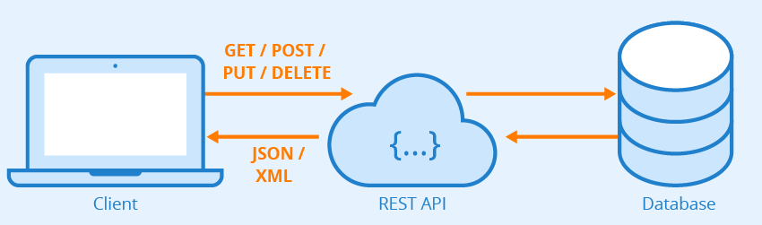
Representational State Transfer (REST) API Service
Architectural style, allowing applications to communicate and exchange data through web URLs using standard HTTP methods
Request methods: GET, POST, PUT, and DELETE.
themealdb API

Slide 8
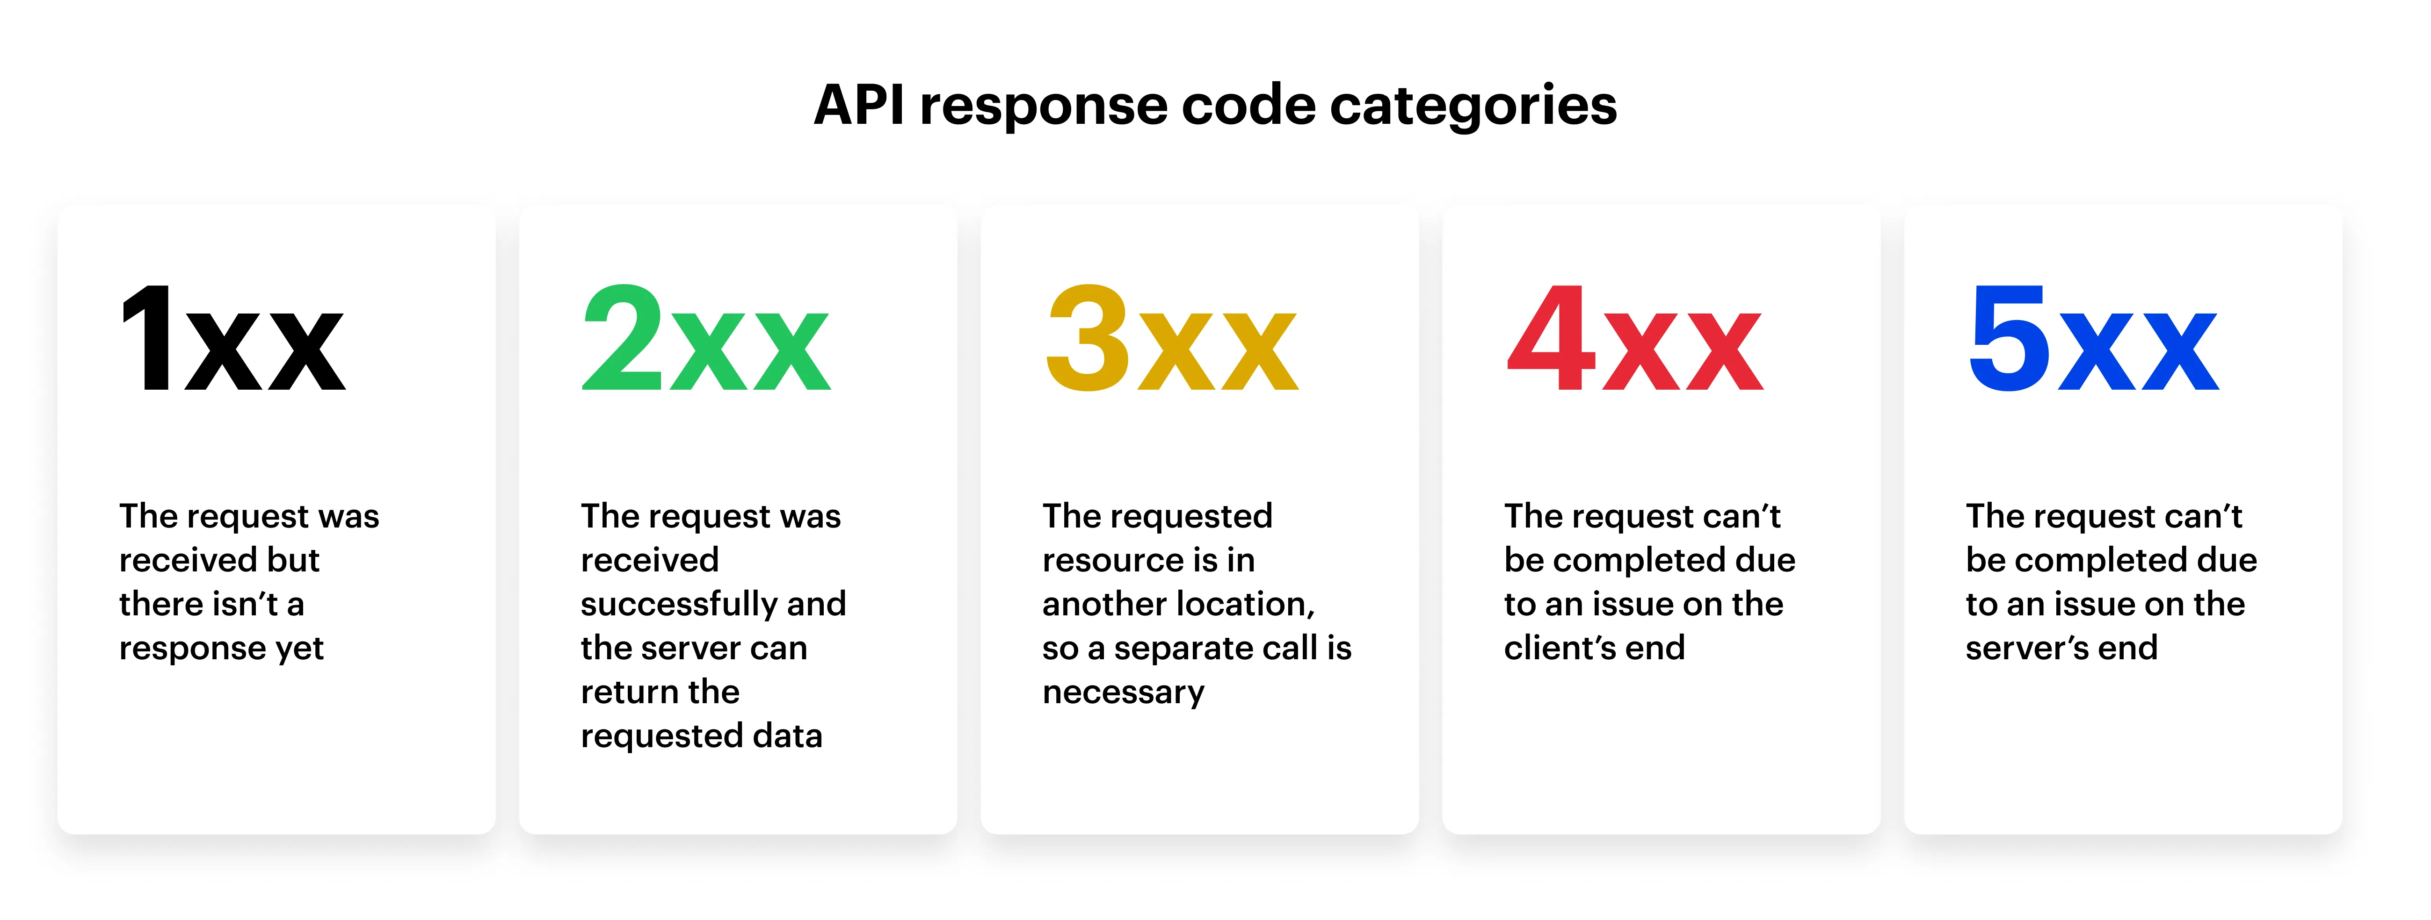
API Response Codes
https://www.thedataschool.co.uk/daniel-bostrom/python-logging/

Slide 9
API Notes

Slide 10


When are APIs used?
Social Media
Application provides an interface for Program to retrieve information from its Database
The program sends an HTTP request to the application and receives a response in JSON or XML format
Essentially, API is a web service plus an authentication protocol like OAuth
Simply Put: You ask something, you get something
Ask: Give me all the IG posts in the past 5 minutes
Get: 50 million posts with metadata
GET or POST HTTP Requests Types

Slide 11
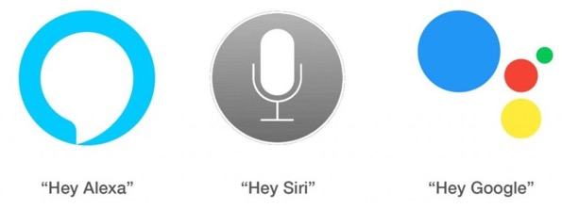

When are APIs used?
Smart Assistants
Question: “Siri, what time is my appointment on Tuesday?”
Answer: “At 3 pm”
Application transcribes voice to text, interprets it, and sends HTTP request
Received response is transformed to voice message
Chatbots
Parse a natural language (e.g. Mandarin, English) query
Transform the instructions into API requests sent to the server
Server receives the API request and transforms it into SQL queries executed on a database

Slide 12
Ask an LLM
Provide examples of API applications

Slide 13
What is JSON?
What is a Primary Format used for Exchanging Data with APIs?
JavaScript Object Notation
It is a Structured format for representing data for storing and exchanging data
It is a data model – has its own structure like an XML
APIs return data in JSON format
Also, optionally, as XML documents or CSVs
XML is old. CSVs can be broken or corrupted, and we do not have the schema
JSONs are the newest and most secure data structure with Faster Transmission speeds

Slide 14
JSON Syntax
Data is in Key/Value pairs
Data is separated by commas
Curly braces hold objects
In this context an object is a set of Key/Value pairs separated by commas
Square brackets hold arrays
An array is a sequence of values which can be accessed randomly, i.e., without having to traverse the previous values
E.G., You can get to the 5th position in an array without having to go through the previous values in the sequence

Slide 15
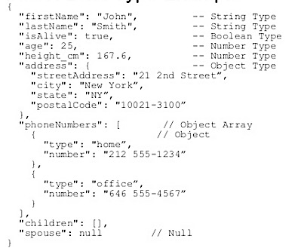
JSON Key/Value Pairs
Consists of a Key in double quotes (i.e., a string) followed by a colon followed by a Value (Keys can be capitalized or in lowercase)
E.g., “city” : “New York”
Values must be one of the following types (No Mixed Data Types):
String
Number
JSON object
Array or List
Boolean
Null

Slide 16
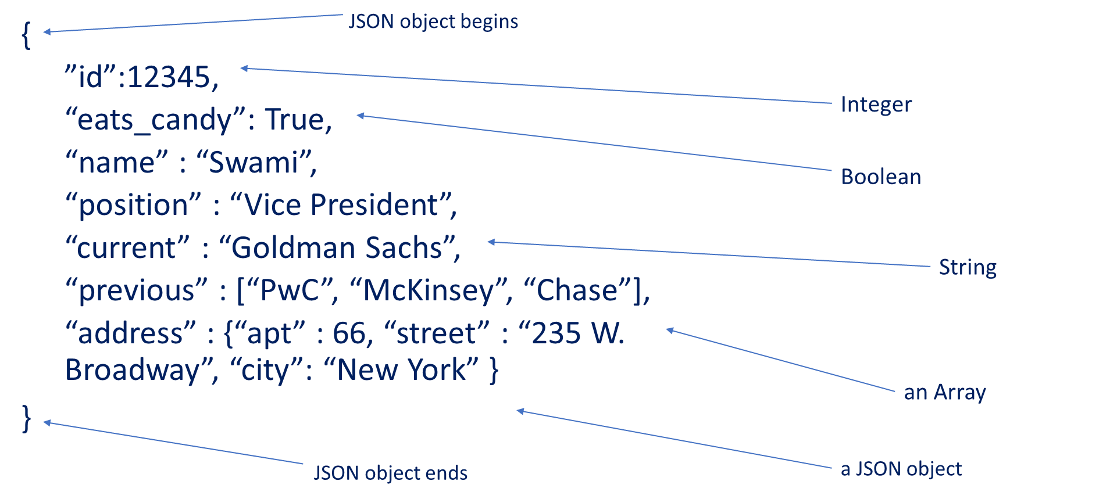
JSON Example

Slide 17
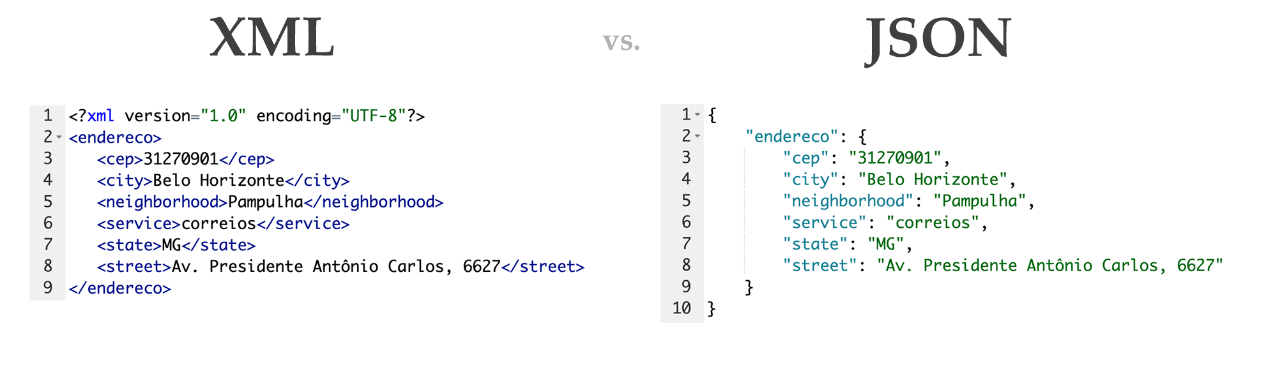
JSON VS XML
https://commons.wikimedia.org/wiki/File:JSON_vs._XML.png

Slide 18
JSON Exercise
Represent the following information in a well-formed JSON object:
Vera BigShot is the President of BigDeal, Inc. She has two pets: a dog named Woof who is three years old and a cat named Meow who is ten years old. She has three homes, one in New York, NY; one in Palm Beach, FL; and one in Flagstaff, AZ. She is not married. Her hobbies are golfing and tormenting students. She was born on June 10, 1995 in Oakland, California.
Note: Represent every fact about her in separate key/value pairs. So don’t put ‘Palm Beach, FL’ as one value — break it up into a city and a state value.

Slide 19
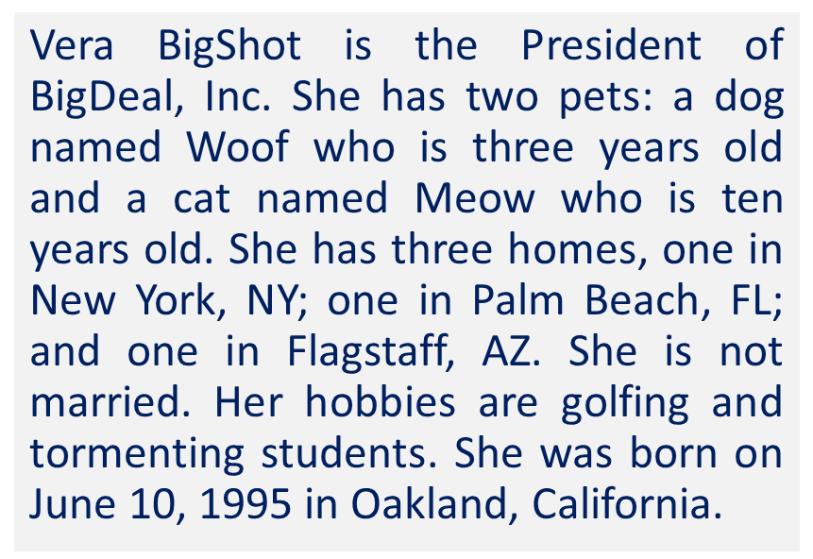
JSON Exercise - Answer
{
“firstname”: “Vera”,
“lastname”: “BigShot”,
”company_position”: “President”,
“company”: “BigDeal”,
“pets”: [
{“type”:”dog”, “name”:“Woof”,“age”: 3},
{“type”:”cat”, “name”:”Meow”,”age”: 10}
],
“home_locations”: [
{“city”: “New York”, “state”: “NY”},
{“city”:” Palm Beach”, “state”: “FL”},
{“city”: “Flagstaff”, “state”: “AZ”}
],
“marital_status”:”single”,
“dob”:”06-10-1995”,
”hometown”: “Oakland”,
“homestate”:”CA”,
”hobbies”: [“golfing”,”tormenting students”]
}

Slide 20
Ask an LLM
Represent the following information in a well-formed JSON object:
Vera BigShot is the President of BigDeal, Inc. She has two pets: a dog named Woof who is three years old and a cat named Meow who is ten years old. She has three homes, one in New York, NY; one in Palm Beach, FL; and one in Flagstaff, AZ. She is not married. Her hobbies are golfing and tormenting students. She was born on June 10, 1995 in Oakland, California.
Note: Represent every fact about her in separate key/value pairs. So don’t put ‘Palm Beach, FL’ as one value — break it up into a city and a state value.

Slide 21
Web Frameworks for Python
A Web framework is a collection of packages or modules
to write Web applications or services
without having to handle such low-level details as protocols, sockets or process/thread management.
Popular frameworks (https://wiki.python.org/moin/WebFrameworks/)
Django
web2py
Flask
Bottle
CherryPy

Slide 22
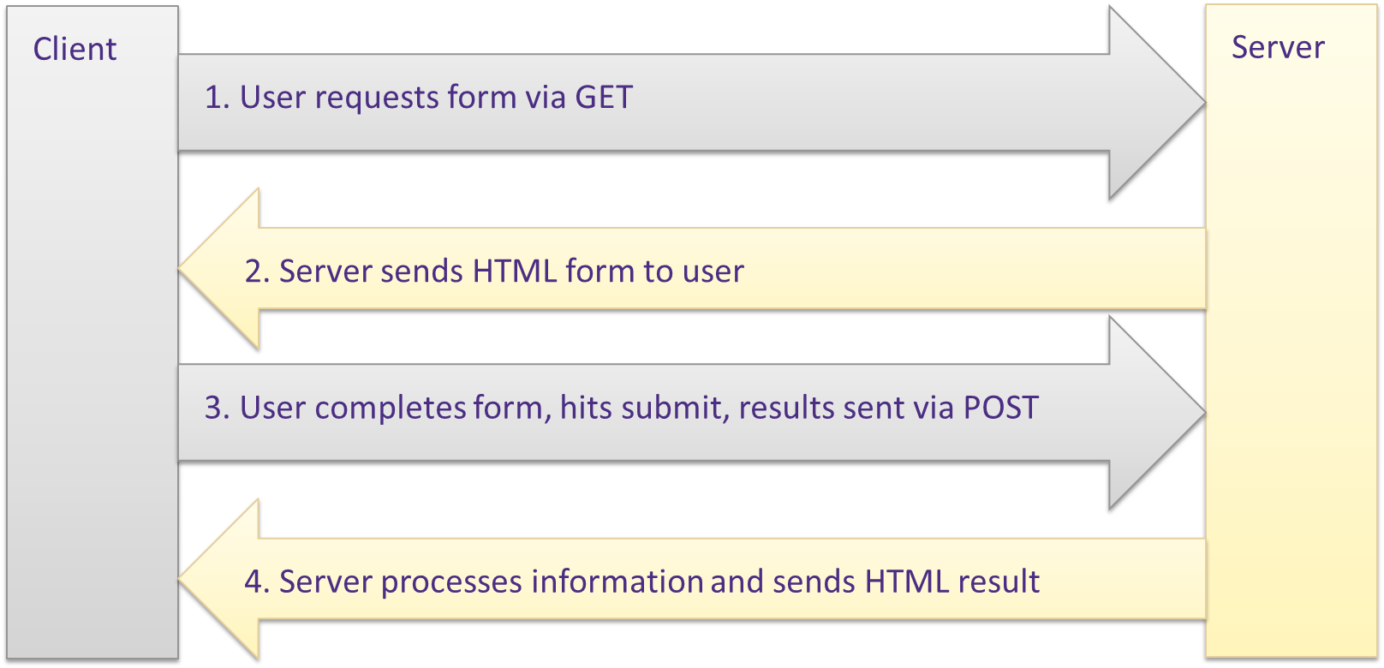
Common flow for web forms

Slide 23
Notebook time

Slide 24
GIT
Git is a distributed version-control system
You keep your files in a repository on your local machine.
You synchronize your repository with a repository on a server.
If you move from one machine to another, you can pick up the changes by synchronizing with the server.
If your partner uploads some changes to your files, you can pick those up by synchronizing with the server.

Slide 25
GIT
Terminology: In git-speak, a “version” is called a “commit.”
Git keeps track of the history of your commits, so you can go back and look at earlier versions, or just give up on the current version and go back some earlier version.

Slide 26
Git and GitHub Notes

Slide 27
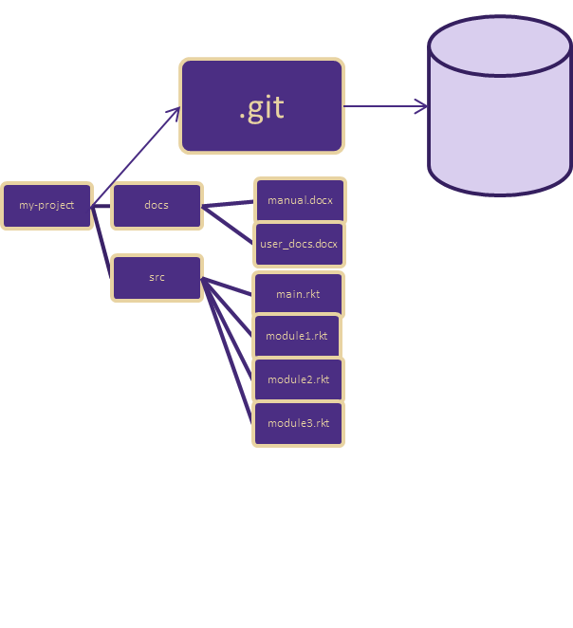
Git
When you have a git repository, you have an additional directory called .git, which points at a mini-filesystem.
This file system keeps all your data, plus the bells and whistles that git needs to do its job.
All this sits on your local machine.

Slide 28
Your workflow (part 1)
You edit your local files directly.
You can edit, add files, delete files, etc., using whatever tools you like.
This doesn’t change the mini-filesystem, so now your mini-fs is behind.

Slide 29
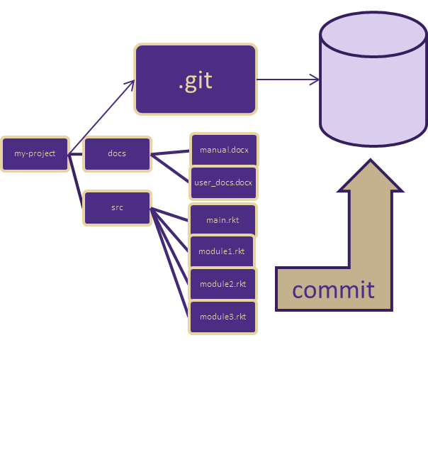
A Commit
When you do a “commit”, you record all your local changes into the mini-fs.
The mini-fs is “append-only”. Nothing is ever over-written there, so everything you ever commit can be recovered.

Slide 30
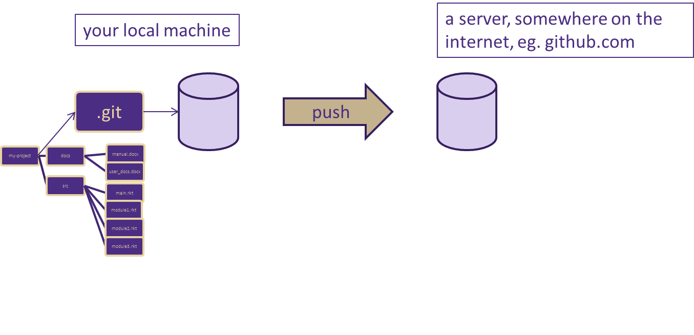
Synchronizing with the server (1)
At the end of each work session, you need to save your changes on the server. This is called a “push”.
Now all your data is backed up.
You can retrieve it, on your machine or some other machine.

Slide 31
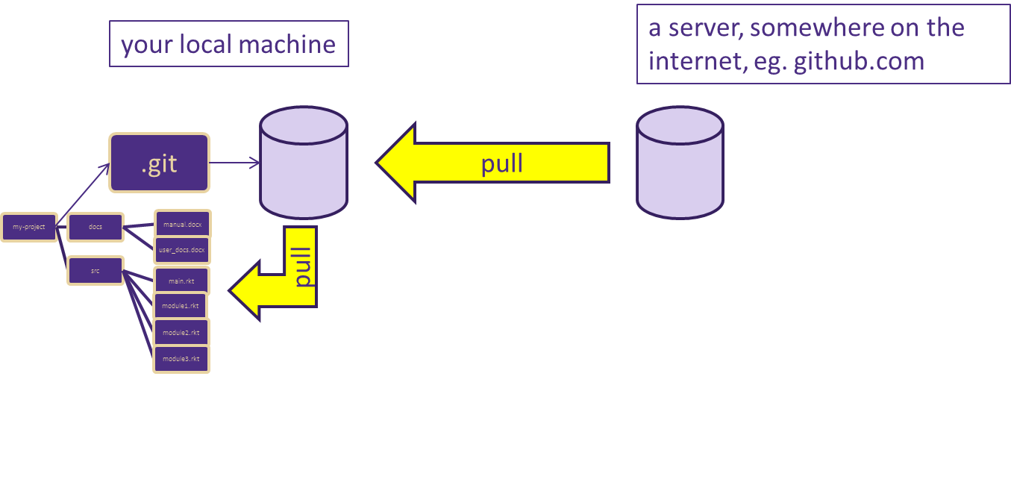
Synchronizing with the server (2)
To retrieve your data from the server, you do a “pull”. A “pull” takes the data from the server and puts it both in your local mini-fs and in your ordinary files.
If your local file has changed, git will merge the changes if possible. If it can’t figure out how to the merge, you will get an error message. We'll learn how to deal with these in the next lesson.

Slide 32
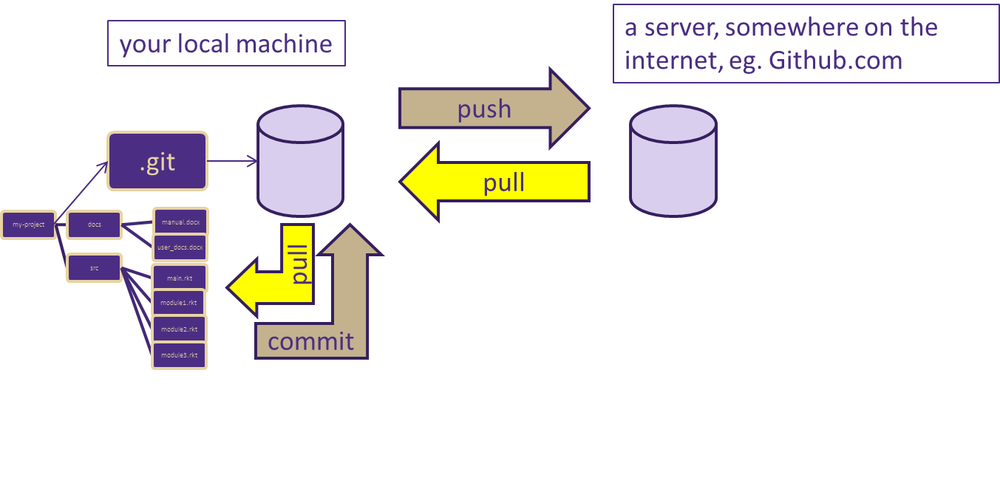
The Full Git Process

Slide 33
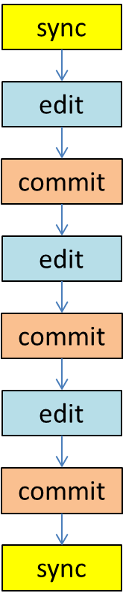
Your Workflow
Best practice: commit your work whenever you’ve gotten one part of your problem working, or before trying something that might fail.
If your new stuff is screwed up, you can always “revert” to your last good commit.

Slide 34
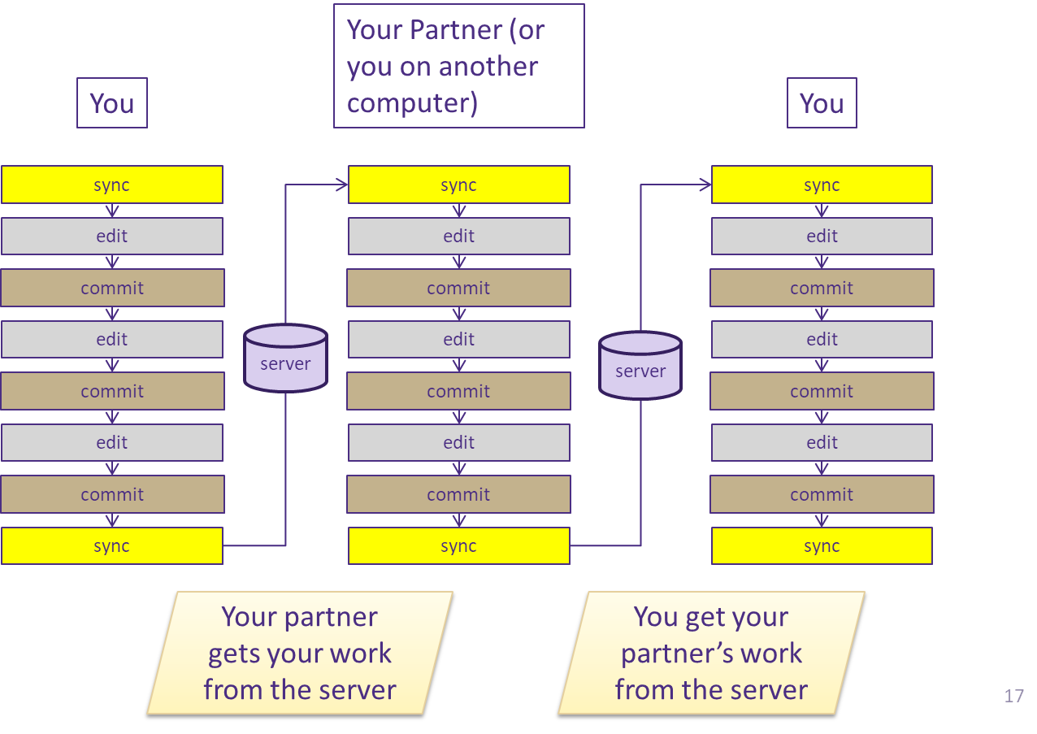
Your Workflow with Others

Slide 35
Common Git commands
Command | Purpose
git status | Shows the current state of your repository, including modified files, staged files, and untracked files.
git add <file> | Stages changes, telling Git which files should be included in the next commit. Use git add . to stage all changes.
git commit -m "message" | Creates a snapshot of the staged changes and saves it to the repository history with a descriptive message.
git push | Uploads your local commits to a remote repository (such as GitHub) so others can access them.
git pull | Downloads the latest changes from the remote repository and merges them into your local branch.

Slide 36
Github Demo

Slide 37
Farewell, and stay connected ☺
Please complete the end course survey on Canvas.
I will submit your final grades one week after the final assignment due date.
Thank you for all your patience and feedback!
Let’s keep in touch! https://www.linkedin.com/in/robertoreif/

